Slide 1

Income Insights:
Who Earns Over 50,000, and Who Earns Under 50,000:
Is there a Wage Gap?
(Based on1994 Census Data)
Maria Meza

Slide 2
Introduction: Main Point

Slide 3
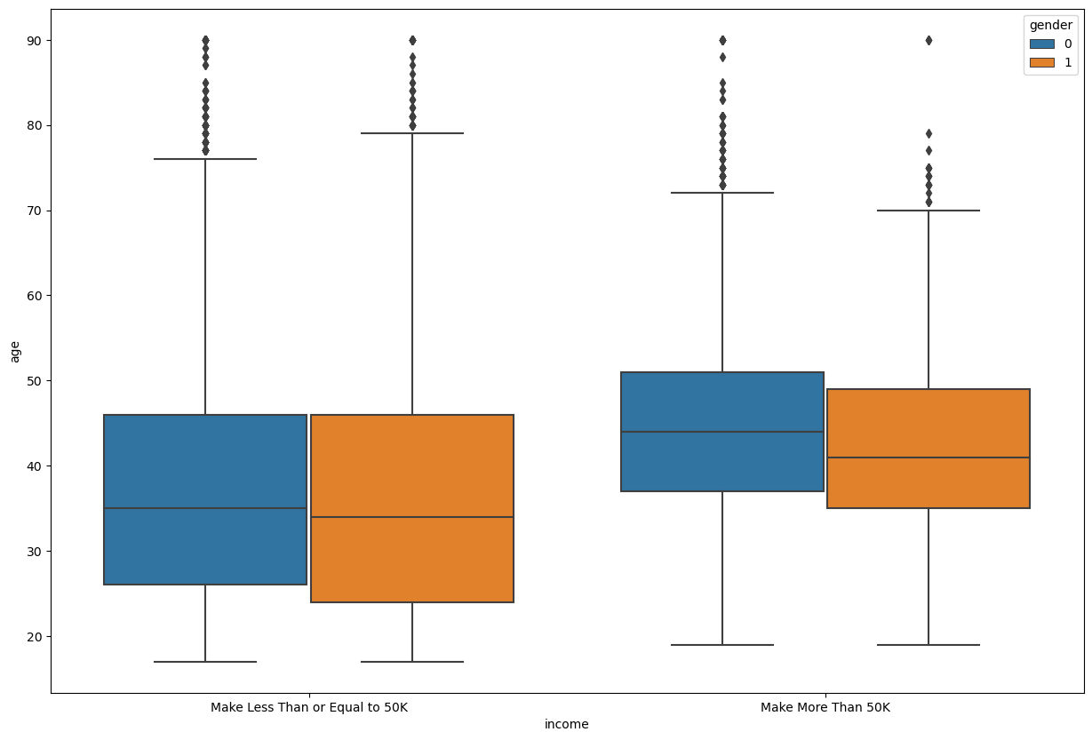
Men Over 40 Who work 30+hours per week Tend To make over 50K
Women tend to make less than men on average

Slide 4
Selecting Factors
How the factors were selected

Slide 5
Factors in consideration
Age
Gender
Hours-per-week
Education

Slide 6
Other Categorical Factors in consideration, with less influence
Occupation
Work class
marital-status
Race & Native Country

Slide 7
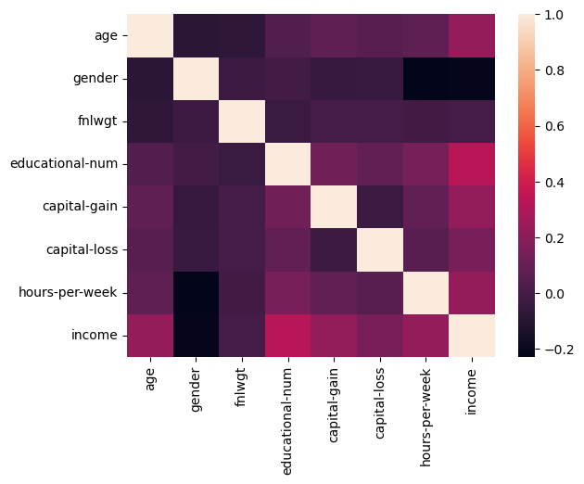
First Hints

Slide 8
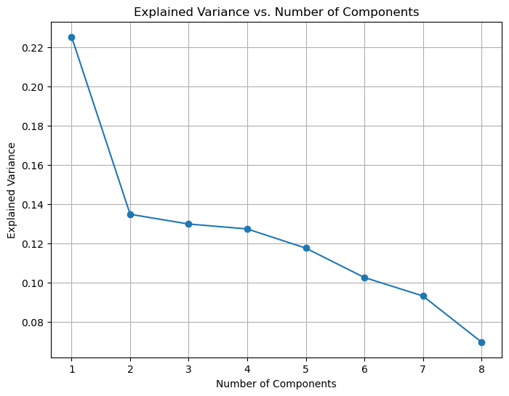
4 features are the right amount of determine features

Slide 9
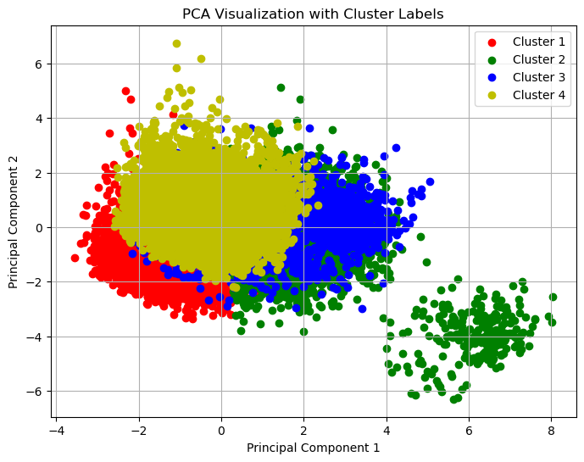
PCA for data visualization
Two Obvious Clusters
In 4 total clusters

Slide 10
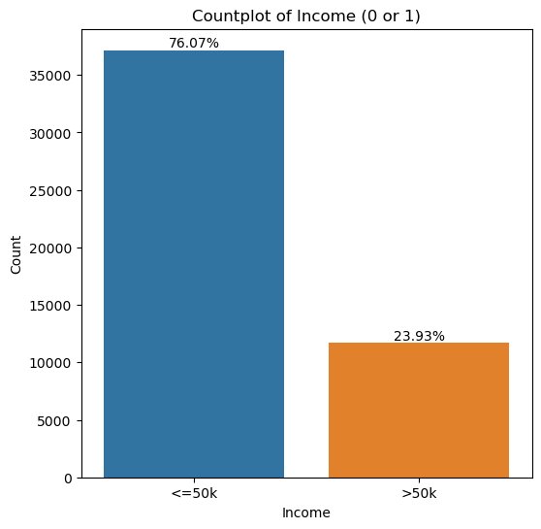
76.07% of people made under 50K in 1994 explain the two clustars

Slide 11
Correlational heat map
Gender and income
Gender and Hours per Week

Slide 12
Why was there a divide

Slide 13
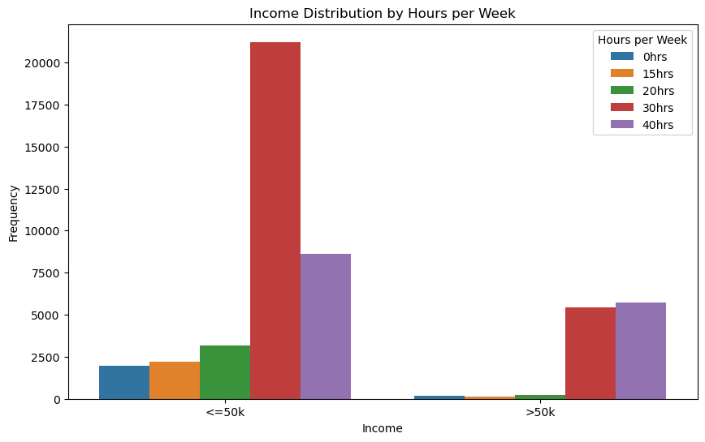
Those who worked over 30hours a week made more than 50k
Hours-per-week

Slide 14
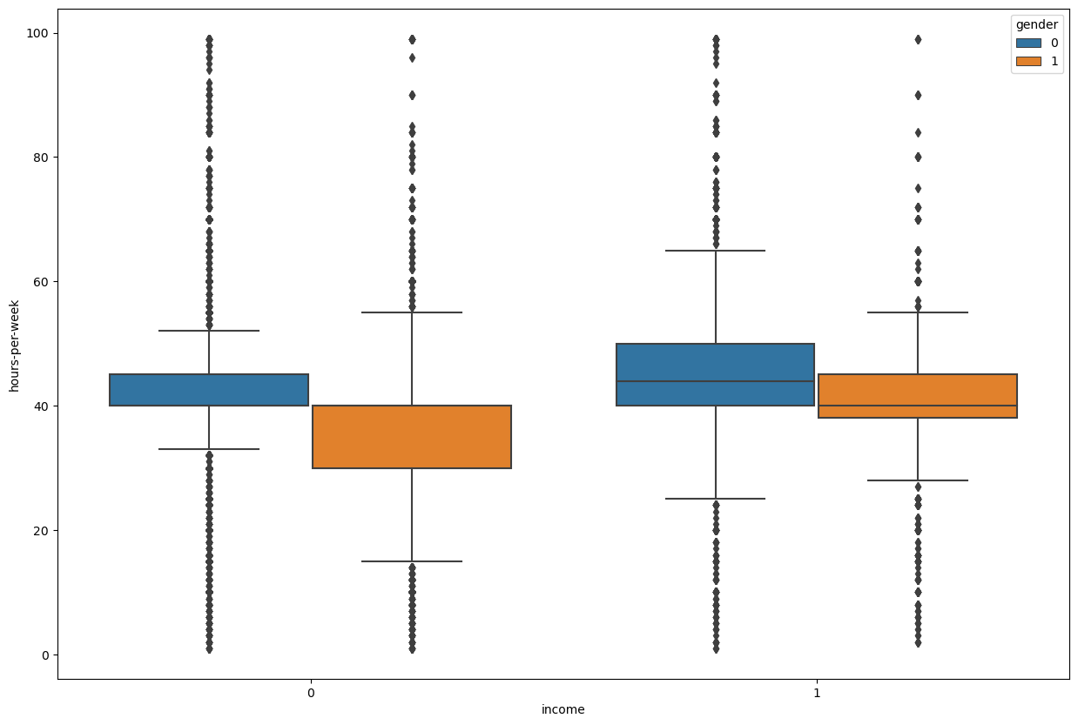
Both Men and women who worked over 30 hours made more in general
Hours-per-week
Income was compared against Hours per week, while being broken down by gender

Slide 15
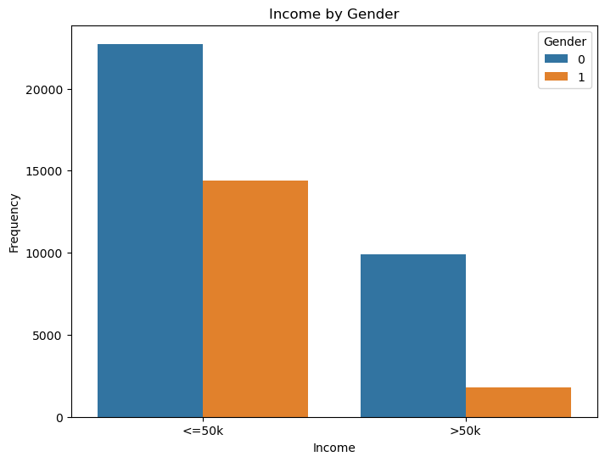
Gender
However, Significantly Less women Made over 50K than men when Graphing Earnings By Gender.

Slide 16
Men and woman 40 and older made over 50k
Age

Slide 17
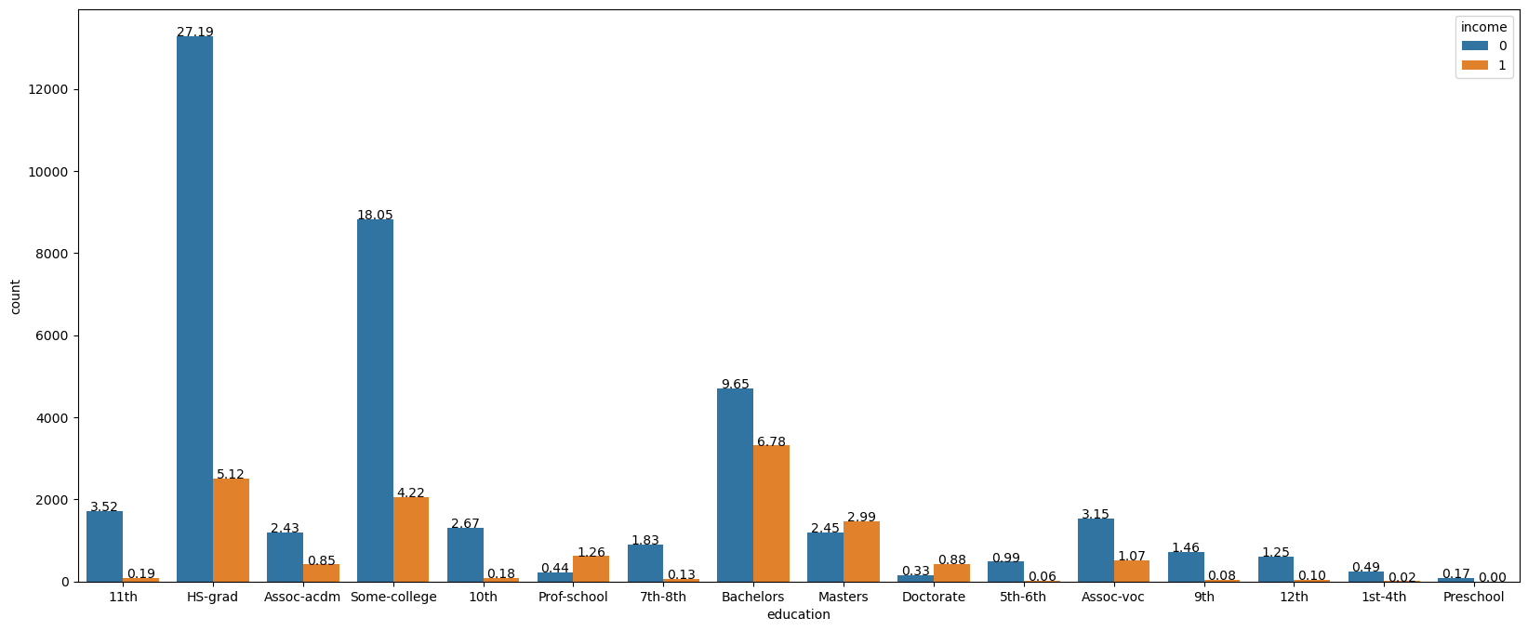
education
Bachelor’s degree
Highschool Grad
Some college

Slide 18
Looking at the Other Factors (Noise)

Slide 19
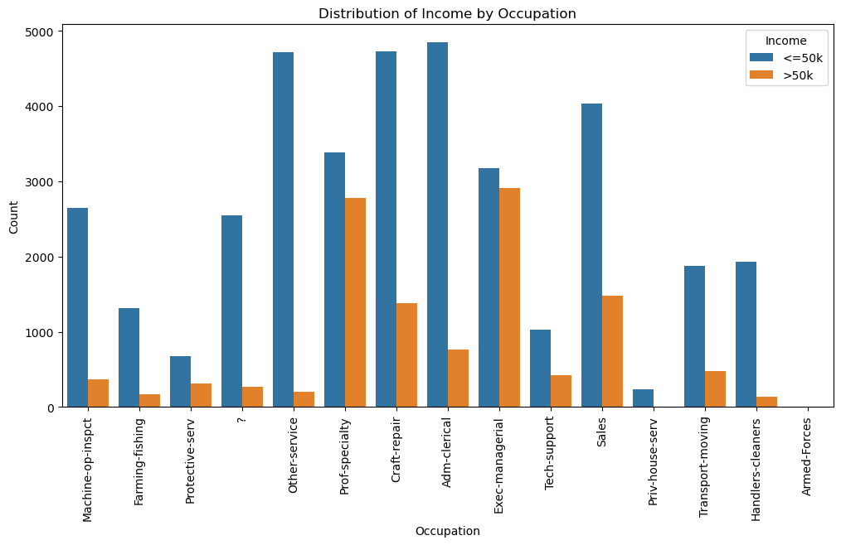
Occupation
Executive management and Prof-specialty have more people who make over 50K but in every occupation , people who earn less than 50K make the majority

Slide 20
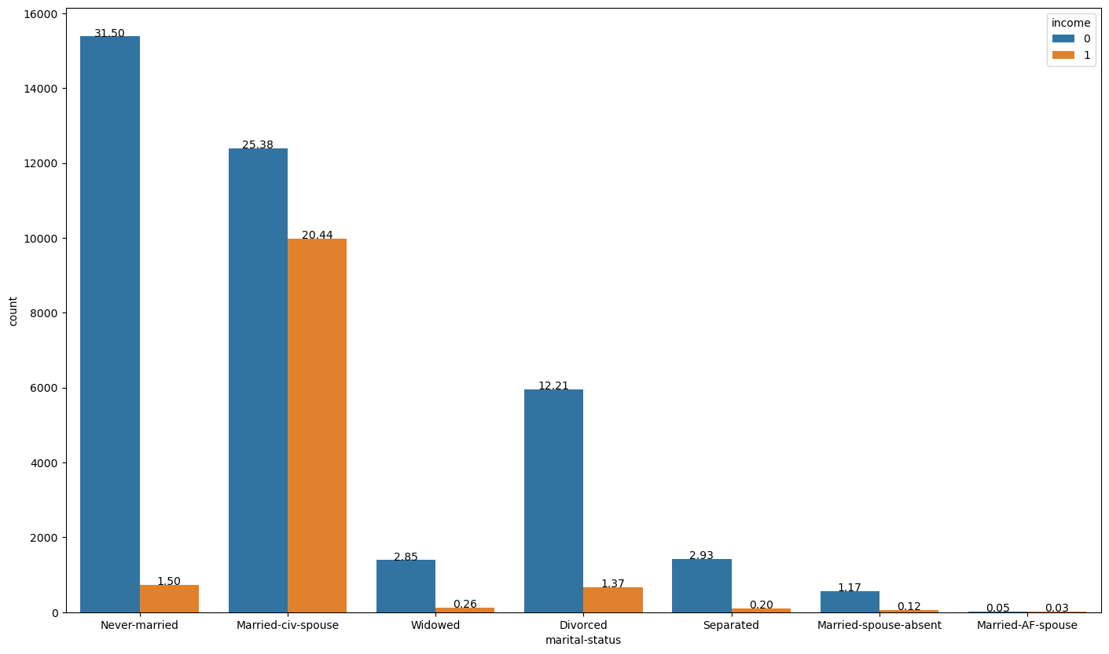
Marital Status
Married –Civ-Spouse has a higher chance of making Over 50K

Slide 21
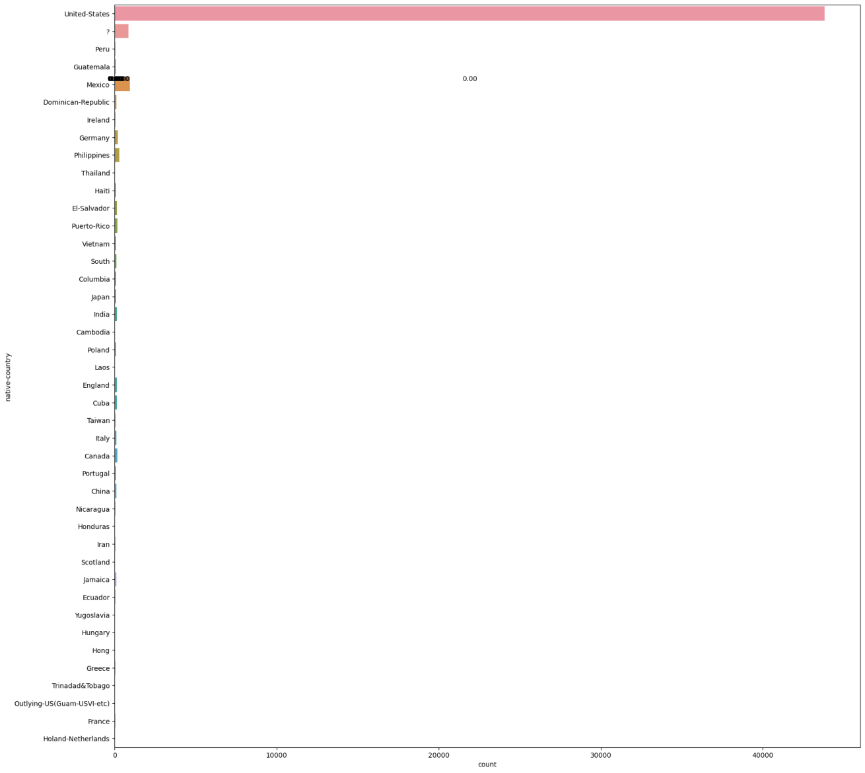
Most people who participated in the census were from the United states, so this data wasn’t useful

Slide 22
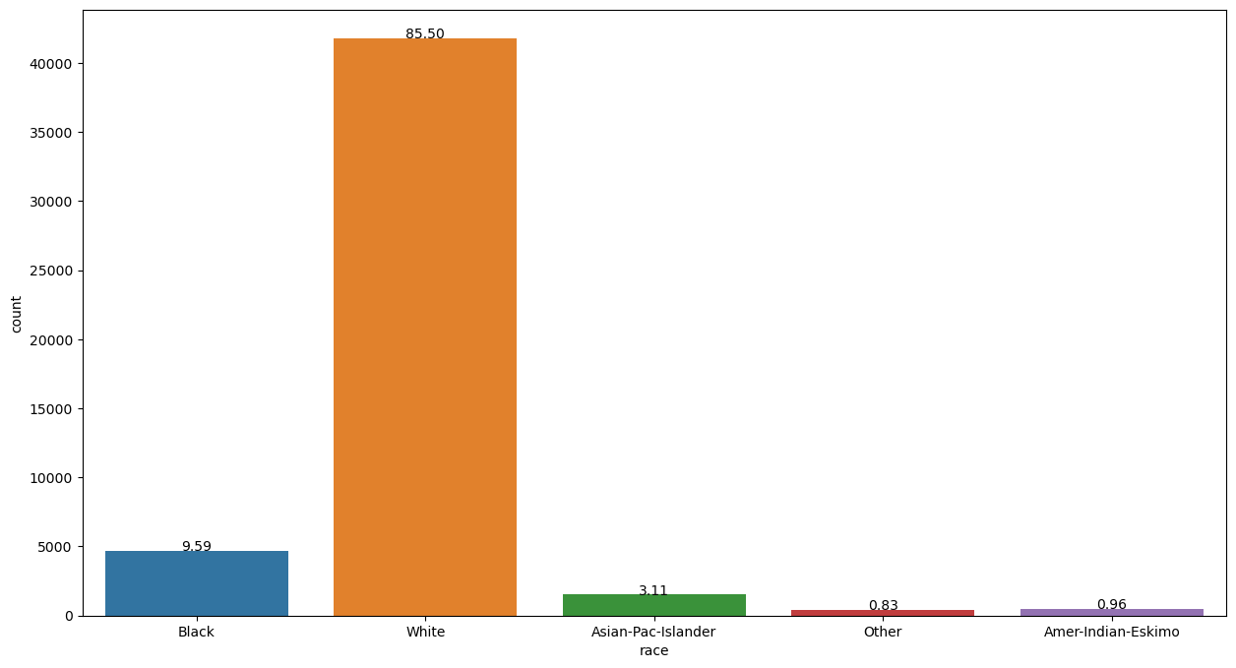
Race
Data is biased towards the white race

Slide 23
Modeling
To predict income

Slide 24
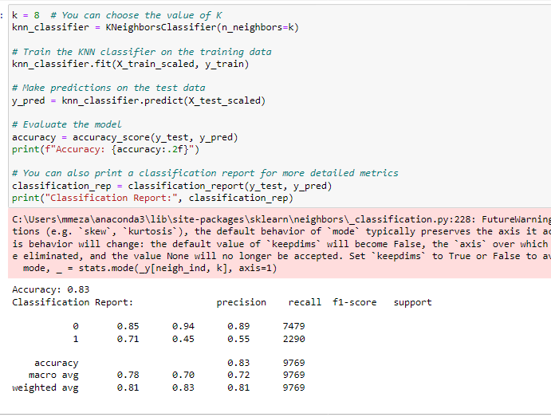
knn
Classifying data
KNN
GridSearch_CV(n_neighbors =8)
Used StandarScalar()

Slide 25
Results
KNN was not the best model.
There was an imbalance of data.

Slide 26
Future Actions
Changing modeling method
Try a decision Tree( forest regression)
Graph RoC Curve
Data Resampling

Slide 27

There is a gap between those who earn under 50k and over 50k
Final point

Slide 28
END

